Slide 1

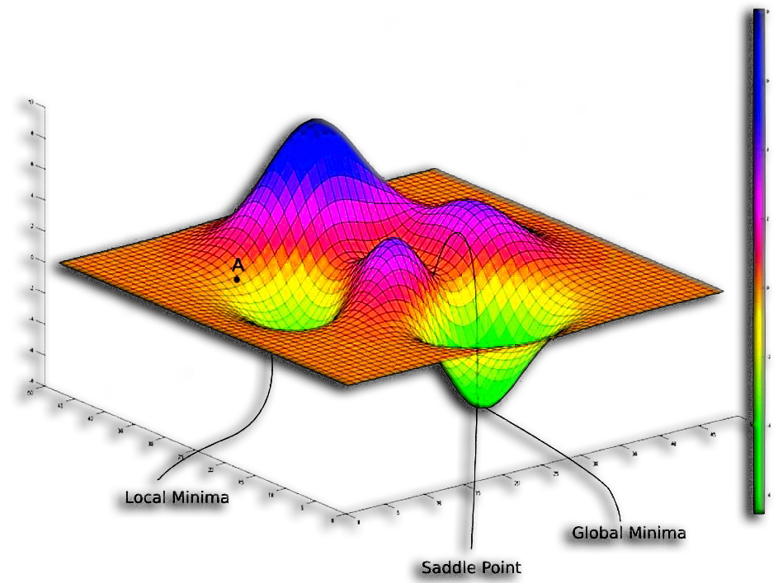


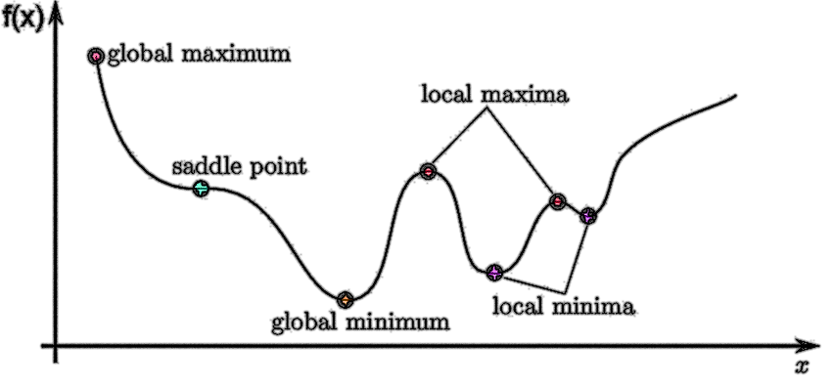

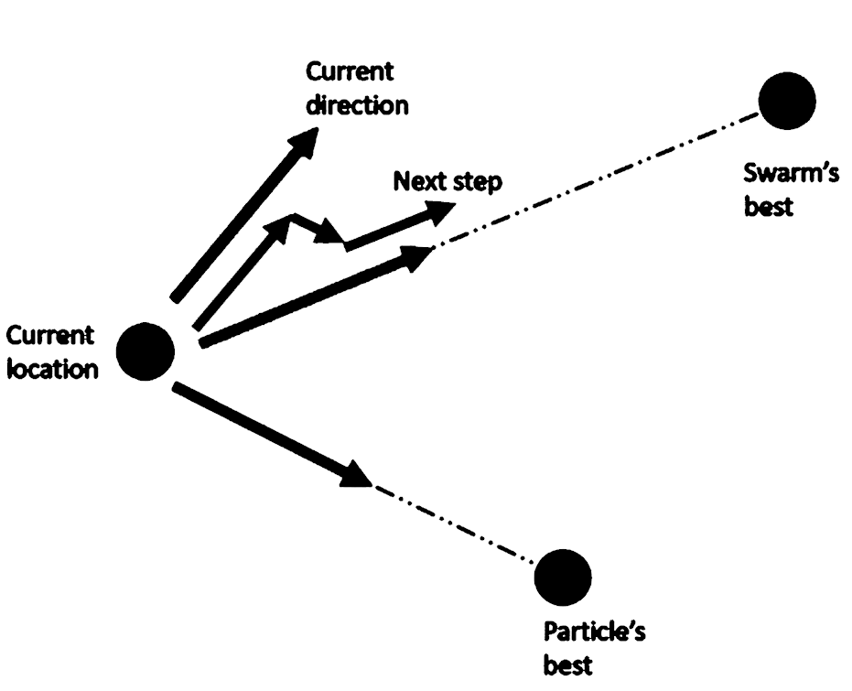
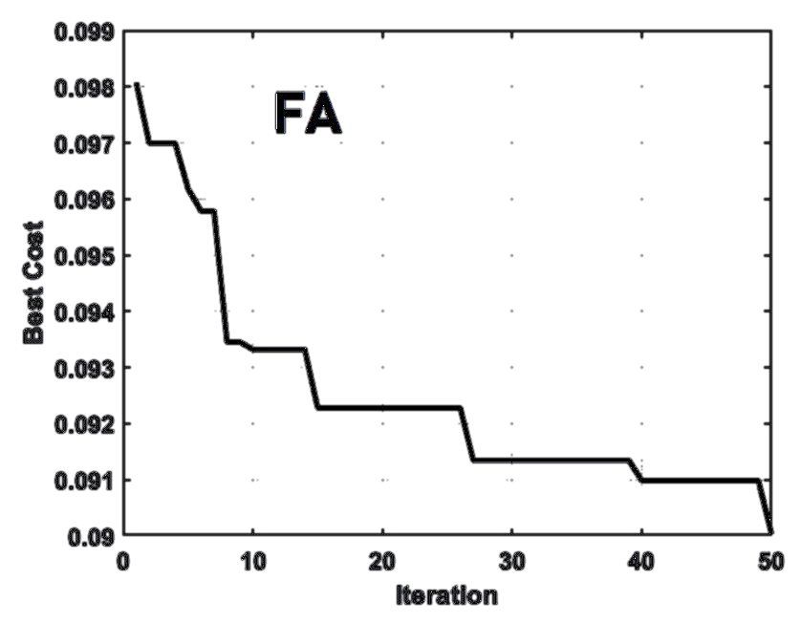

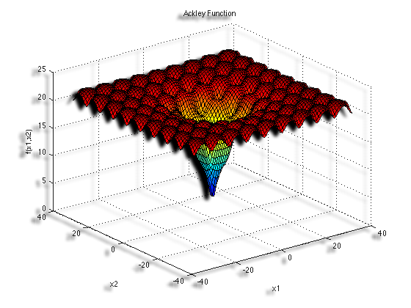

Complexity Example Results for Economic Dispatching Problem by Bess Algorithm:
Best Cost: 16202.85
Convergence time (seconds): 1.5400832176208496
Memory used (MB): 0.18390625
Number of operations performed: 2135
Complexity Class: O(n_scout_bees * max_iter * nPlant)
Complexity Name: Linearithmic (O(n * log n))
Optimization
By: Seyed Muhammad Hossein Mousavi
2024-2025

Slide 2
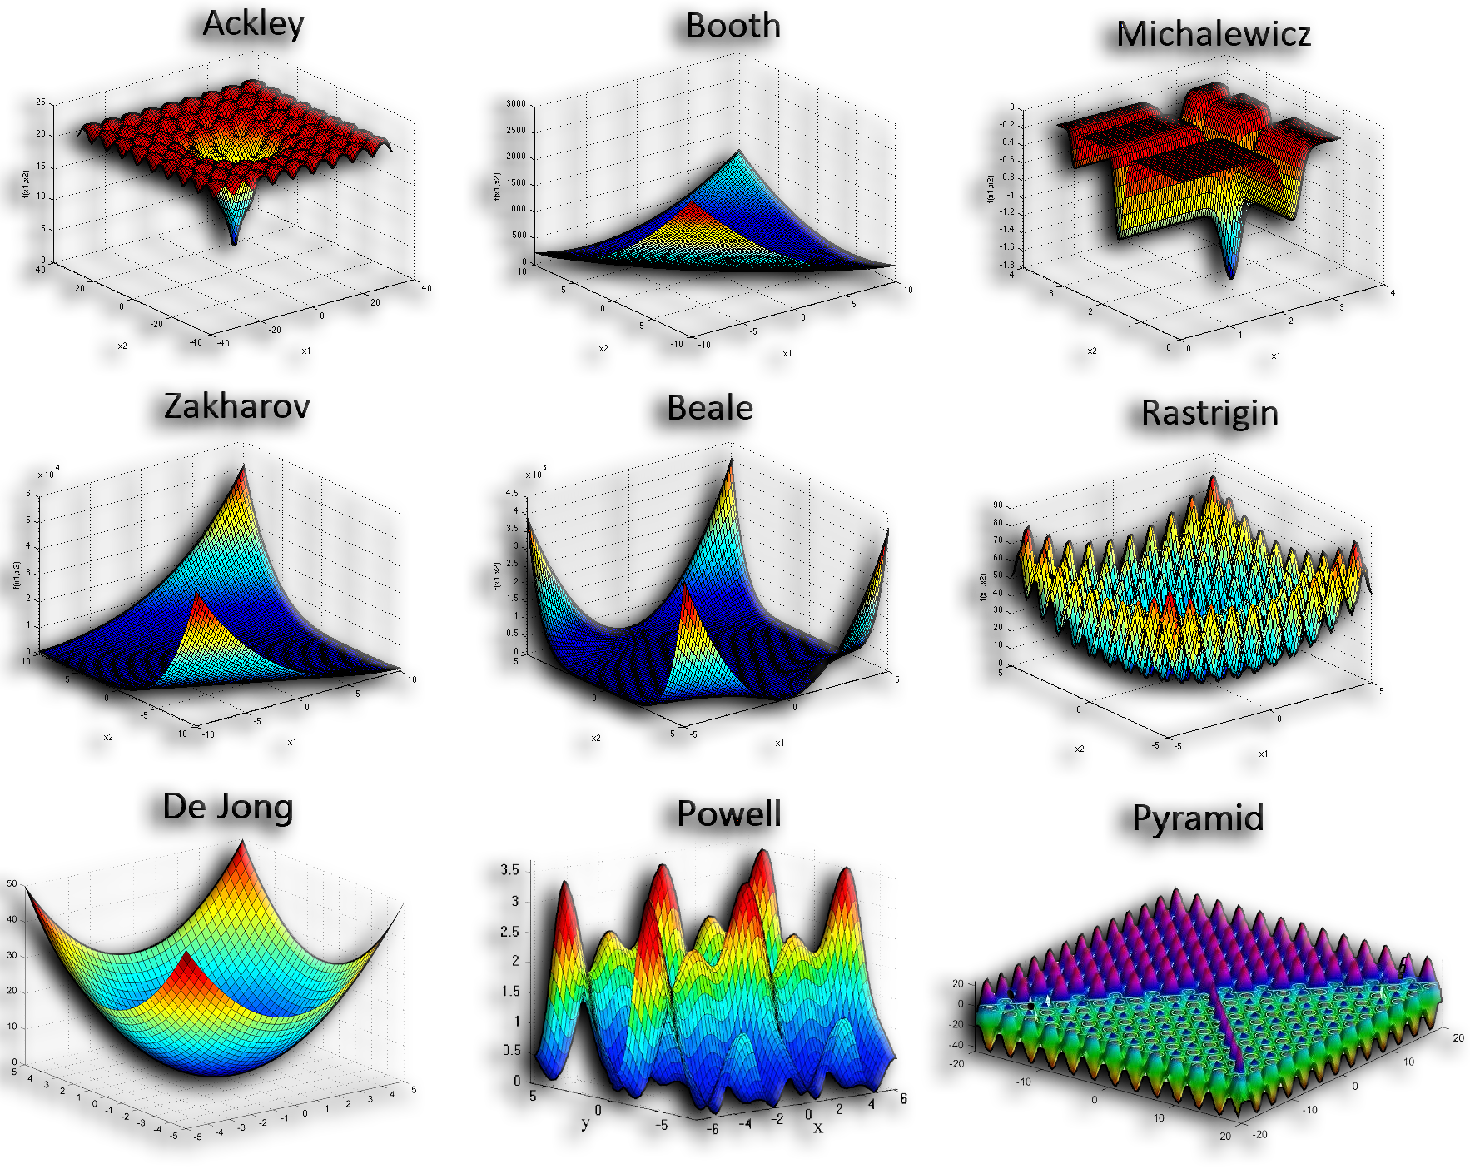

Outline:
Optimization
Definitions
Importance
Main Types
Algorithms
Optimization Test Functions
Optimization Problems

Slide 3

Optimization
Definitions
Optimization is the process of finding the best solution or outcome from a set of possible possibilities while satisfying given constraints.
It involves maximizing or minimizing a specific objective function, such as cost or fitness.
An objective function is a mathematical expression that defines the goal of an optimization problem.
It evaluates the quality of a solution and guides the search for the optimal result.
Potential solutions in optimization problems called critical points.
Critical points occur where the derivative (gradient) of the objective function is zero or undefined.
This means there is no slope, and the function "flattens out" at these points.
Critical points are classified into four main categories:
Global Maximum: The highest value of the objective function across the entire domain of the problem (the best in the case of the fitness function).
Global Minimum: The lowest value of the objective function across the entire domain of the problem (the best in the case of the cost function). In most cases, we are looking for the best value for the cost function.
Local Maximum: The highest value of the objective function within a specific region or neighborhood.
Local Minimum: The lowest value of the objective function within a specific region or neighborhood.
Saddle Point: A point where the objective function is neither a local maximum nor a local minimum.

Slide 4
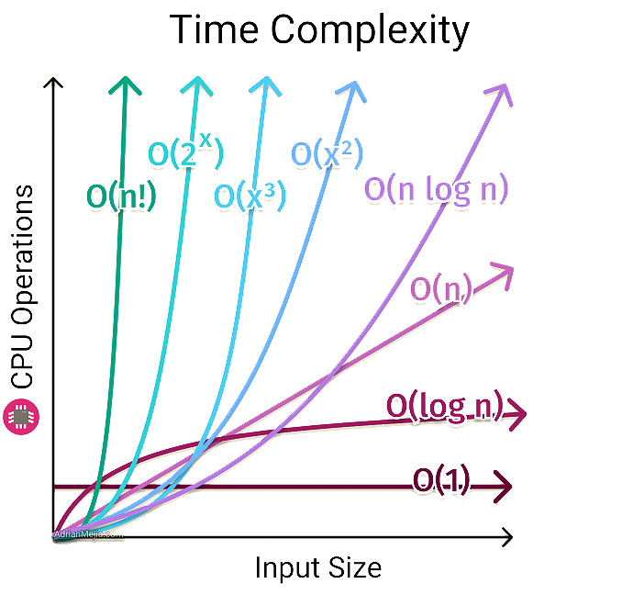
Optimization
Definitions
Exploration and Exploitation:
Exploration is the primary phase, where the algorithm searches broadly across the solution space to identify promising regions or solutions. It helps discover areas that might contain the global optimum.
Exploitation is the secondary phase where the algorithm focuses on refining or improving solutions within those promising regions discovered during exploration. It fine-tunes the results to approach the optimum.
A constraint is a condition or rule that solutions must satisfy (e.g., budget limits, resource capacities).
Complexity is the complexity of an algorithm is the amount of resources required to run the algorithm.
It goes from the fastest/less complex of O(1) to the slowest/most complex of O(n!).

Slide 5
Optimization
Definition
Visualization of Critical Points in Optimization

Slide 6
Optimization
Definition
3-D Visualization of Critical Points in Optimization on a Test Function

Slide 7

Optimization
Importance
Efficiency Improvement: Optimization minimizes resource usage (time, cost, energy) while achieving desired outcomes, enabling processes to operate more efficiently.
Cost Reduction: It helps reduce expenses in industries by finding the most cost-effective solutions without compromising quality or performance.
Performance Enhancement: Optimization improves system or product performance by fine-tuning parameters to achieve the best results under given constraints.
Decision-Making Support: It provides data-driven, optimal choices in complex scenarios, aiding businesses and individuals in making better decisions.
Maximizing Profits: By optimizing resource allocation and processes, organizations can maximize returns, productivity, and profitability.
Sustainability Promotion: Optimization contributes to sustainable practices by reducing waste, energy consumption, and environmental impact in operations.
Innovation and Advancement: It drives innovation by finding creative solutions to complex problems and pushing the boundaries of technology and design.

Slide 8

Optimization
Main Types
Gradient-Based Optimization: Relies on derivatives to iteratively find optima, suitable for smooth and differentiable problems.
Gradient-Free Optimization: Operates without gradient information, ideal for non-differentiable or noisy problems.
Heuristics: Problem-specific approaches using simple rules to provide quick, often suboptimal solutions.
Metaheuristics: General frameworks for global search, balancing exploration and exploitation, covering diverse problems. (Here, we concentrate more on Metaheuristics)
Evolutionary Algorithms: Subset of metaheuristics inspired by biological evolution (e.g., Genetic Algorithms, Differential Evolution).
Swarm Intelligence Algorithms: Subset of metaheuristics inspired by collective behaviors in nature (e.g., PSO, Firefly Algorithm, and Ant Colony Optimization).
Physics-Based Optimization: Inspired by physical processes like annealing or gravitation to find near-optimal solutions (such as Simulated Annealing or Harmony Search).
Human-Based Algorithms: Inspired by human decision-making and behavior (e.g., Teaching-Learning-Based Optimization, Brain Storm Optimization, Tabu Search, and Imperialist Competitive Algorithm).
Bayesian Optimization: Uses probabilistic models to optimize expensive, black-box functions.

Slide 9
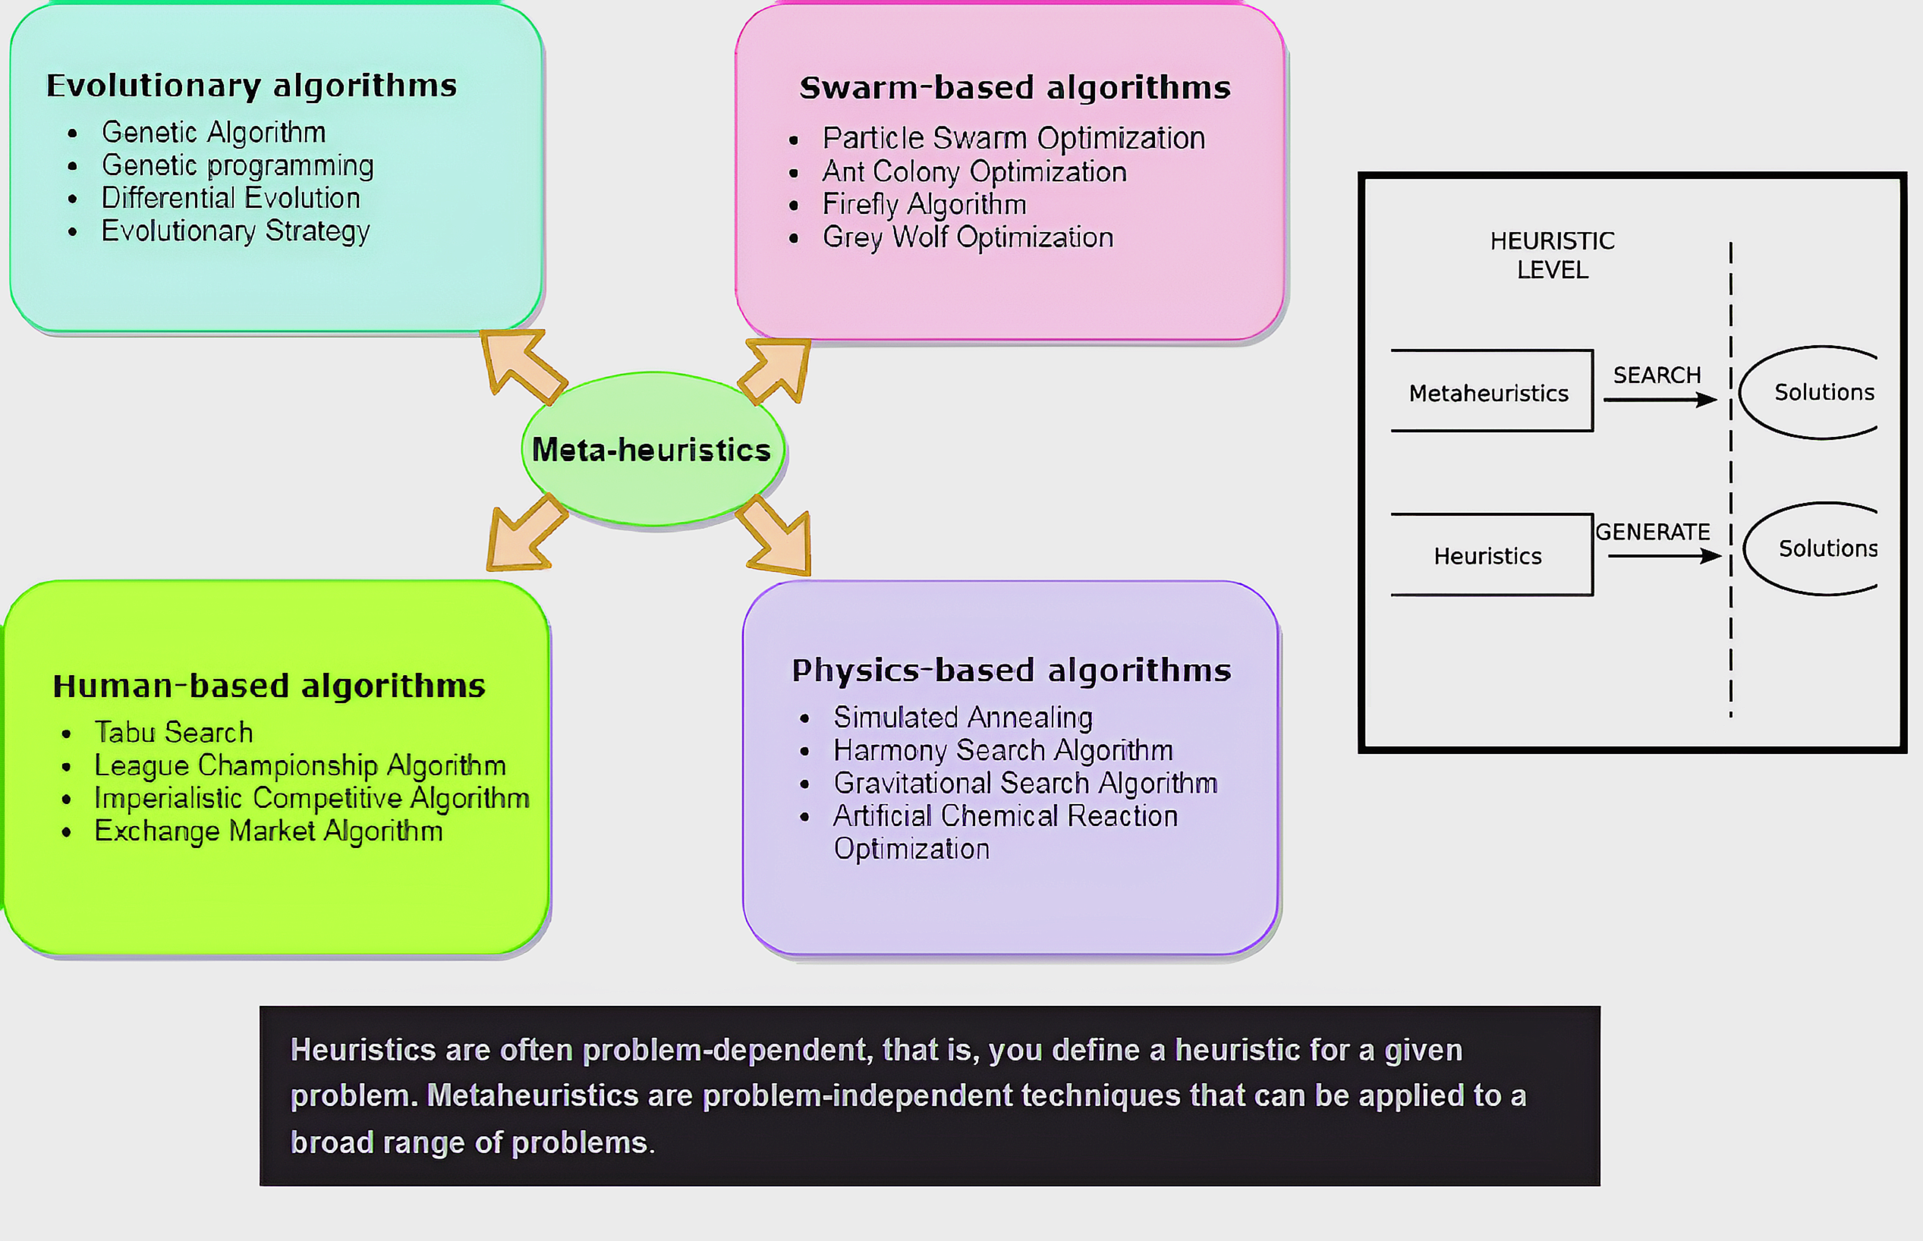

Slide 10
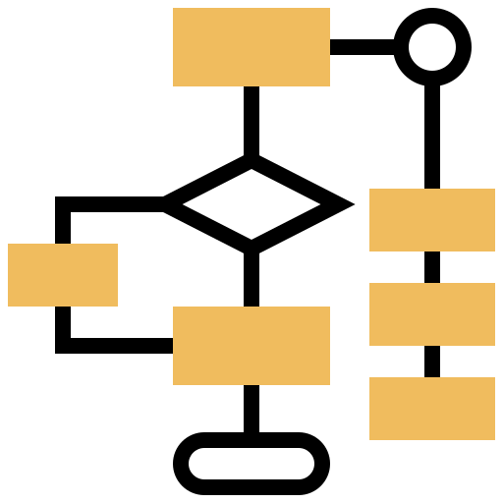
Optimization
Algorithms
Gradient-Based Optimization
Gradient Descent: Iteratively moves in the direction of the steepest descent to minimize a function.
Newton's Method: Uses second-order derivatives for faster convergence in smooth problems.
Stochastic Gradient Descent (SGD): A variant of Gradient Descent that updates weights using random subsets of data.
Gradient-Free Optimization
Nelder-Mead: A simplex-based method for finding minima in non-differentiable problems.
Powell’s Method: An iterative optimization method that does not require derivatives.
Heuristics
Hill Climbing: A greedy algorithm that iteratively improves the solution by moving to better neighbors.
Best-First Search: Explores a search tree by selecting the node with the lowest estimated cost to the goal, prioritizing the most promising paths first.
Bayesian Optimization
Gaussian Process Optimization: Builds probabilistic models to optimize expensive black-box functions.
Tree-Structured Parzen Estimator (TPE): A Bayesian method for hyperparameter tuning in machine learning.

Slide 11
Optimization
Algorithms
Metaheuristics
Evolutionary Algorithms
Genetic Algorithm (GA): Mimics natural selection to evolve solutions to optimization problems.
Differential Evolution (DE): Optimizes by evolving candidate solutions based on differences between them.
NSGA-II (Non-dominated Sorting Genetic Algorithm-II): A fast and elitist evolutionary algorithm for solving multi-objective optimization problems, maintaining diversity.
Evolutionary Strategy (ES): Inspired by biological evolution, focusing on mutation and selection to iteratively improve candidate solutions for real-valued optimization problems.
Swarm Intelligence Algorithms
Particle Swarm Optimization (PSO): Simulates social behavior of swarms to explore the solution space.
Ant Colony Optimization (ACO): Mimics the foraging behavior of ants to find optimal paths.
Firefly Algorithm (FA): Mimics the flashing behavior of fireflies, using light intensity to attract others and guide the search for optimal solutions.
Gray Wolf Optimizer (GWO): Mimics the hunting and leadership hierarchy of gray wolves to balance exploration and exploitation in finding optimal solutions.

Slide 12
Optimization
Algorithms
Metaheuristics
Swarm Intelligence Algorithms (continue)
Victoria Amazonica Optimization (VAO): Simulates the growth and leaf arrangement of the Victoria Amazonica water lily, utilizing its efficient spatial coverage to solve optimization problems effectively.
Weevil Damage Optimization Algorithm (WDOA): It is inspired by weevil behaviors—specifically their flying, snout, and damaging capabilities—designed to solve complex optimization problems by mimicking these natural processes.
Bess Algorithm (BA): Mimics the foraging behavior of bees to explore and exploit the solution space effectively.
MOEA/D (Multi-Objective Evolutionary Algorithm based on Decomposition): Breaks multi-objective problems into simpler subproblems to optimize.
Human-Based Algorithms
Teaching-Learning-Based Optimization (TLBO): Models the teaching-learning process to refine solutions.
Brain Storm Optimization (BSO): Simulates human brainstorming for idea generation and refinement.

Slide 13
Optimization
Algorithms
Metaheuristics
Human-Based Algorithms (continue)
Tabu Search (TS): It uses memory structures to avoid revisiting previously explored solutions, enabling efficient exploration of the solution space.
Imperialist Competitive Algorithm (ICA): A socio-political metaheuristic inspired by imperialistic competition, where countries (solutions) compete to take over colonies and improve their fitness for global optimization problems.
Physics-Based Optimization
Simulated Annealing (SA): Mimics the annealing process in metals to escape local optima.
Gravitational Search Algorithm (GSA): Models the gravitational attraction between objects to find optima.
Harmony Search (HS): A music-inspired optimization algorithm that mimics the improvisation process of musicians to find the optimal solution by balancing exploration and exploitation.
Galaxy Gravity Optimization (GGO): A physics-inspired optimization algorithm that models the gravitational interactions within a galaxy to explore and converge toward optimal solutions effectively.

Slide 14
Optimization
Optimization Test Functions
Test functions in optimization are mathematical functions used to evaluate and compare the performance of optimization algorithms.
These functions are carefully designed to represent different kinds of challenges that optimization algorithms might face, such as non-convexity, multimodality (multiple local optima), or rugged landscapes.
They allow researchers to compare the performance of different optimization algorithms on the same problems under specific conditions.
They simulate real-world problem complexities to analyze the robustness and adaptability of optimization techniques.
They are generally categorized into the categories of unimodal and multimodal.
Unimodal, which has a single global optimum and is used to test the convergence speed and accuracy of an algorithm like sphere or rosenbrock functions.
Multimodal, which has multiple local optima and at least one global optimum and is used to test an algorithm's ability to escape local optima and find the global optimum. Such as Ackley or rastrigin functions.

Slide 15
Optimization
Optimization Test Functions
Ackley (Multimodal): Features many local minima but one global minimum. It is used to test an algorithm's ability to converge to the global minimum in a noisy, multimodal landscape.
Booth (Unimodal): A simple function with a single global minimum. Useful for testing optimization algorithms in a smooth and convex landscape.
Michalewicz (Multimodal): Contains multiple local minima, making it challenging for algorithms. Tests the ability to avoid local optima and find the global minimum.
Zakharov (Unimodal): A bowl-shaped function. It evaluates how efficiently an algorithm can handle linear and quadratic terms.
Branin (Multimodal): A multimodal function with three global minima. Used for testing algorithms' exploration and exploitation balance.
Schwefel (Multimodal): Features many local minima. Tests an algorithm's ability to navigate through large search spaces with deceptive local minima.
Beale (Unimodal): A smooth function with a single global minimum. It evaluates an algorithm's performance in smooth, nonlinear spaces.

Slide 16
Optimization
Optimization Test Functions
Rastrigin (Multimodal): Contains many regularly spaced local minima. It is widely used to test optimization algorithms in high-dimensional spaces.
De Jong (Sphere) (Unimodal): A simple quadratic function. It is a basic benchmark for testing an algorithm's convergence speed.
Powell (Unimodal): A complex function with flat regions. Tests an algorithm’s performance in scenarios where gradients are small.
Egg Holder (Multimodal): A highly non-convex, multimodal function. Used to test algorithms' exploration capabilities.
Easom (Multimodal): Has a single sharp global minimum and is flat elsewhere. It challenges algorithms to find the minimum in scattered information regions.
Pyramid (Multimodal): Contains many evenly spaced peaks. Used to evaluate an algorithm's global search capabilities.
Dixon (Unimodal): Tests the convergence behavior of optimization methods with quadratic features.
Bukin 6 (Multimodal): Features a narrow valley with many ridges. Tests algorithms' precision and navigation in constrained spaces.
Cross-in-Tray (Multimodal): Highly complex with multiple minima. Tests the exploration of rugged landscapes.

Slide 17
Optimization
Optimization Test Functions
Trid (Unimodal): A simple, bowl-shaped function. Useful for algorithms testing smooth landscapes.
Rosenbrock (Unimodal): A well-known function with a narrow valley leading to the global minimum. It tests an algorithm's convergence efficiency.
Griewank (Multimodal): Features many local minima and a single global minimum. It evaluates algorithms' exploration in non-convex spaces.
Bohachevsky (Unimodal): A simpler variant of the Rastrigin function. Useful for testing convergence on smooth surfaces.
Goldstein-Price (Multimodal): A function with multiple local minima. Used to test algorithms' robustness in complex landscapes.
Matyas (Unimodal): A symmetric, bowl-shaped function. Used to test optimization methods in smooth, low-dimensional landscapes.
Bird (Multimodal): Highly complex with multiple minima. Used to test algorithms’ ability to explore rugged terrains.
Levy (Multimodal): Tests algorithms' global search capability with its deceptive local minima.

Slide 18
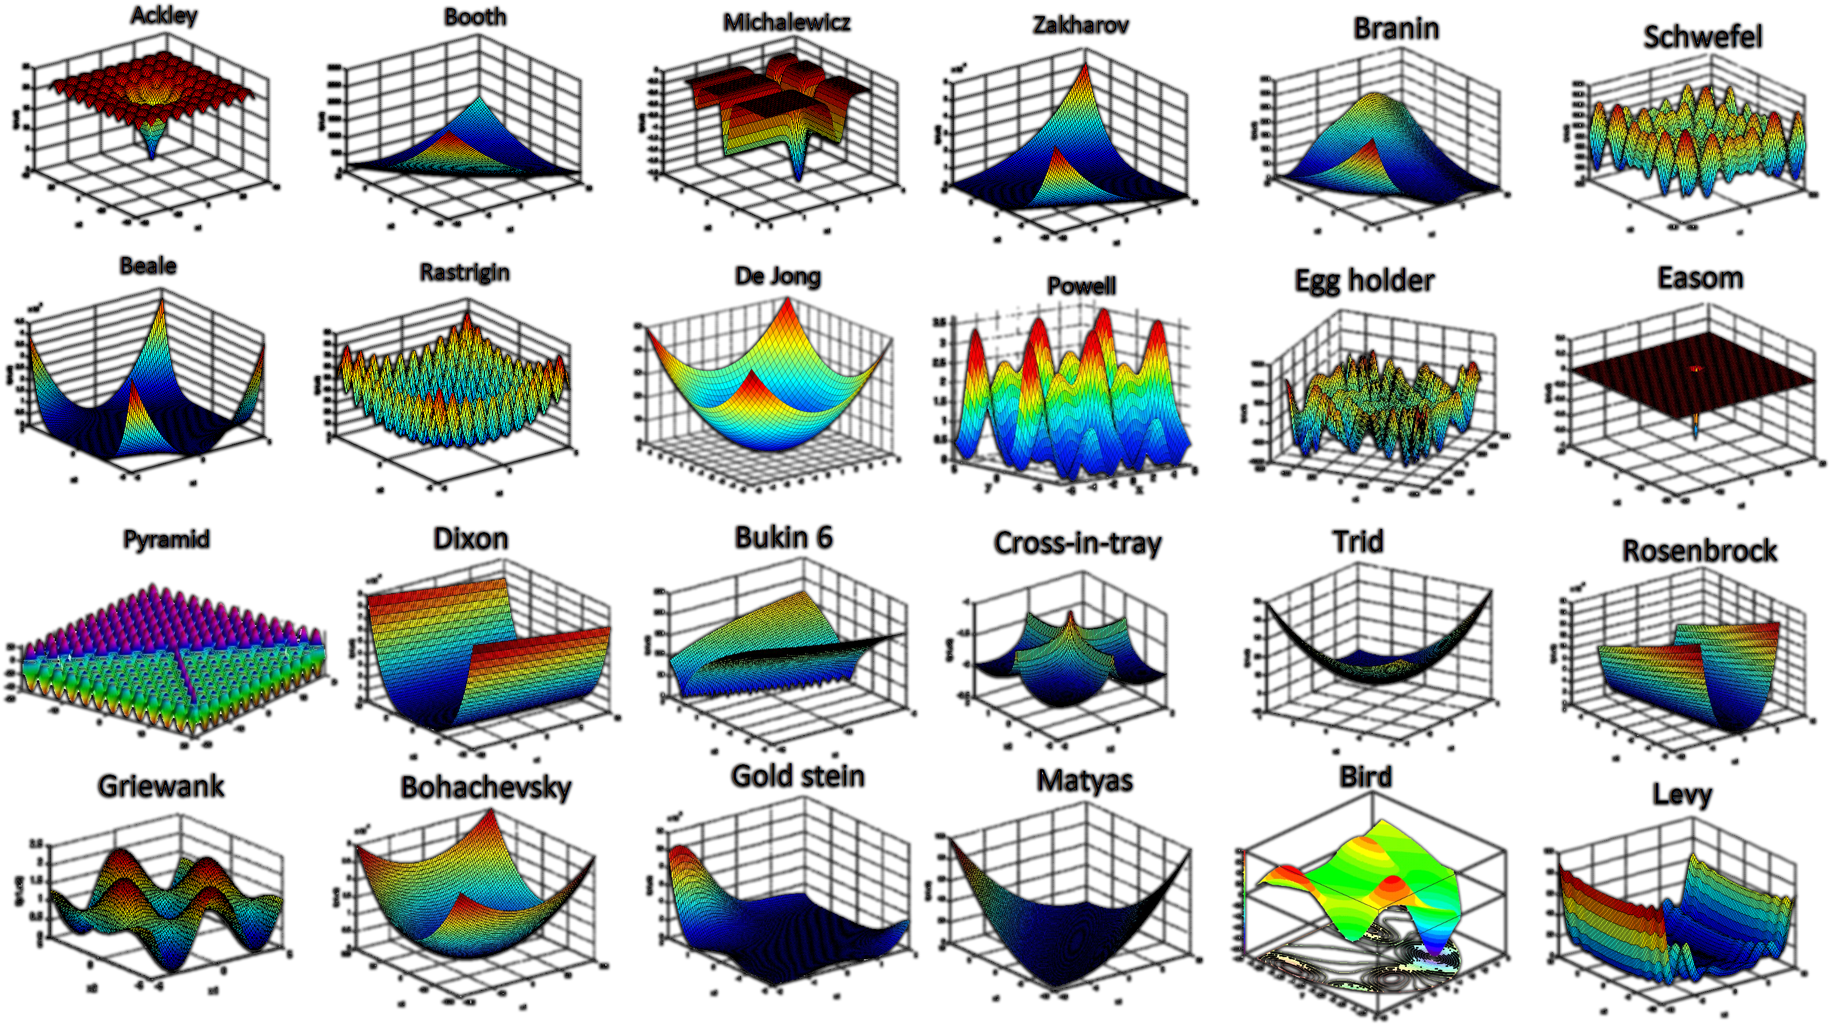

Slide 19
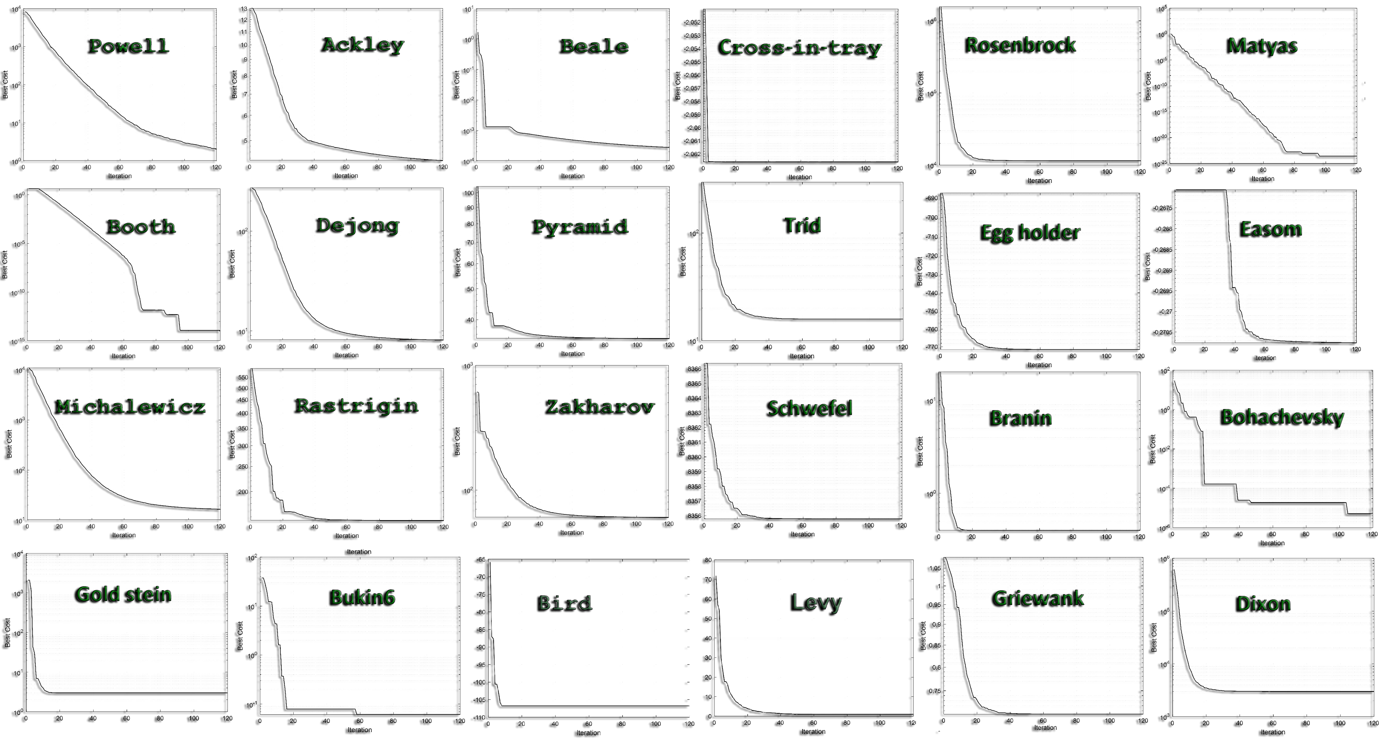

Slide 20

Optimization
Optimization Problems
Clustering
Problem: Group data points into clusters where points in the same cluster are similar and points in different clusters are dissimilar.
Default Methods: Algorithms like k-means iteratively assign points to clusters based on simple distance metrics, but they can get stuck in suboptimal solutions (local minima).
Optimization's Improvement: Optimization algorithms explore a larger solution space and avoid local optima by globally minimizing the clustering objective, resulting in more robust clustering for complex or high-dimensional data.
Regression
Problem: Predict a target variable by modeling the relationship between inputs and outputs.
Default Methods: Nonlinear regression uses techniques like Least Squares or Gradient Descent, but they can get stuck in local minima or struggle with complex relationships.
Optimization Improvement: Optimization algorithms perform global searches, handle complex objective functions, and provide more robust solutions for noisy or highly nonlinear data.

Slide 21
Optimization
Optimization Problems
Minimum Spanning Tree (MST)
Problem: Find the subset of edges in a connected graph that connects all nodes with the minimum total weight without forming cycles.
Default Methods: Algorithms like Kruskal’s and Prim’s use greedy approaches to construct the MST but may not efficiently handle dynamic changes or constraints in large, complex graphs.
Optimization's Improvement: Global optimization approaches can handle additional constraints (e.g., specific edges must be included/excluded) and adapt to dynamic or multi-objective scenarios that default methods cannot.
Hub Location Allocation (HLA)
Problem: Identify optimal hub locations and allocate demand points to these hubs to minimize transportation costs or maximize efficiency in a network.
Default Methods: Heuristic or greedy algorithms allocate hubs based on proximity or fixed cost models but may struggle with complex demand patterns or additional constraints.
Optimization Improvement: Global optimization approaches can balance multiple objectives (e.g., cost and time) and incorporate complex constraints like hub capacity, dynamic demands, or multi-tier allocations.

Slide 22
Optimization
Optimization Problems
Traveling Salesman Problem (TSP)
Problem: Determine the shortest possible route that visits each city exactly once and returns to the starting point.
Default Methods: Greedy approaches like Nearest Neighbor quickly find solutions but often result in suboptimal routes, especially for larger problems.
Optimization Improvement: Optimization methods explore the global solution space, balancing exploration and exploitation to find near-optimal or globally optimal routes for complex, large-scale instances or multi-objective scenarios.
Vehicle Routing Problem (VRP)
Problem: Plan optimal routes for a fleet of vehicles to deliver goods to multiple locations while minimizing costs and meeting constraints like capacity and time windows.
Default Methods: Heuristic approaches, like Clarke-Wright Savings or nearest neighbor, provide quick solutions but may fail to handle complex constraints effectively in large-scale or dynamic scenarios.
Optimization Improvement: Global optimization methods can incorporate multiple constraints (e.g., vehicle capacity, delivery windows) and objectives (e.g., cost, distance), ensuring more efficient and scalable solutions for real-world applications.

Slide 23
Optimization
Optimization Problems
Economic Dispatching (ED)
Problem: Determine the optimal power output of multiple generators to meet electricity demand while minimizing total generation costs.
Default Methods: Traditional methods like Lambda-Iteration or Gradient Descent solve linear cost models but struggle with nonlinear cost functions or constraints like generator limits and transmission losses.
Optimization Improvement: Advanced approaches can handle complex nonlinearities, multiple objectives (e.g., cost and emissions), and real-world constraints, leading to more precise and efficient dispatch solutions.
Image Segmentation
Problem: Partition an image into distinct regions (e.g., separating objects from the background) to extract meaningful information for tasks like object detection or medical imaging.
Default Methods: Techniques like thresholding or edge detection rely on basic intensity differences, which often fail in noisy or complex images with overlapping textures.
Optimization Improvement: Optimization-based methods globally minimize cost functions that balance region similarity and boundary smoothness, leading to more accurate and robust segmentation for challenging datasets.

Slide 24
Optimization
Optimization Problems
Feature Selection
Problem: Identify the most relevant subset of features from a dataset to improve model performance while reducing complexity and overfitting.
Default Methods: Techniques like correlation-based filtering or forward selection evaluate features individually or sequentially but may miss interactions between features or subsets.
Optimization Improvement: Global optimization approaches explore the full search space to identify feature combinations that maximize model performance while adhering to constraints, such as limiting feature count or minimizing redundancy.
Bin Packing
Problem: Assign items of varying sizes to a fixed number of bins in a way that minimizes the number of bins used or maximizes space utilization.
Default Methods: Greedy algorithms like First-Fit or Best-Fit assign items sequentially, often leading to suboptimal packing configurations.
Optimization Improvement: Global optimization approaches consider the overall packing arrangement, balancing space utilization and constraints like item priority or weight limits, leading to more efficient and feasible solutions.

Slide 25
Optimization
Optimization Problems
Quadratic Assignment Problem (QAP)
Problem: Assign a set of facilities to a set of locations to minimize the total cost, where costs depend on the flow between facilities and the distance between locations.
Default Methods: Heuristics or greedy algorithms provide quick solutions but often fail to find near-optimal assignments in large or highly interconnected problems.
Optimization Improvement: Global optimization approaches efficiently explore the solution space, handling complex interactions between facilities and locations to achieve more accurate and cost-effective assignments.
Parallel Machine Scheduling (PMS)
Problem: Assign jobs to multiple parallel machines to minimize the total completion time, makespan, or other objectives while considering constraints like machine capacity or job priorities.
Default Methods: Heuristic algorithms, such as Shortest Processing Time (SPT) or Earliest Due Date (EDD), provide quick but often suboptimal schedules.
Optimization Improvement: Global optimization approaches explore the solution space more effectively, balancing job allocation and machine utilization under complex constraints to achieve near-optimal schedules.

Slide 26
Optimization
Optimization Problems
Resource Allocation
Problem: Distribute limited resources among competing activities to maximize efficiency or achieve specific objectives while meeting constraints.
Default Methods: Simple rule-based approaches or greedy algorithms allocate resources based on predefined priorities but often fail to account for complex dependencies or trade-offs.
Optimization Improvement: Advanced approaches explore the allocation space globally, balancing competing objectives and constraints (e.g., costs, time, or capacity) for more efficient and effective resource utilization.

Slide 27
Optimization
Optimization Problems
Evolved Antenna
Problem: Design an antenna with specific performance characteristics (e.g., frequency range, signal strength) while adhering to physical and operational constraints.
Default Methods: Conventional design relies on predefined templates and manual adjustments, often requiring significant trial and error to meet complex requirements.
Optimization Improvement: Optimization approaches automate the design process, exploring a wide range of configurations to evolve novel and efficient antenna structures that outperform manually designed counterparts.
Space-Time Bending
Problem: Design and optimize spacetime configurations for specific purposes, such as simulating gravitational effects, modeling relativistic phenomena, or exploring advanced physics scenarios.
Default Methods: Traditional approaches rely on fixed theoretical models or numerical approximations, which can be computationally intensive and may not adapt well to complex constraints.
Optimization Improvement: Advanced optimization methods explore a broader range of spacetime geometries, dynamically balancing constraints like energy, mass distribution, and curvature to achieve more accurate and efficient models for specific applications.

Slide 28
Optimization
Optimization Problems
Protein Structure Prediction (PSP)
Problem: Predict the 3D structure of a protein from its amino acid sequence to understand its function and interactions.
Default Methods: Rule-based methods or sequence alignment approaches rely on known templates or heuristics, which often fail for novel or complex proteins without similar known structures.
Optimization Improvement: Optimization approaches explore the vast conformational space, balancing energy minimization and structural constraints to predict more accurate and stable 3D structures, even for novel proteins.
Exoplanetary Adaptation
Problem: Adapt human genetics for survival on exoplanets with extreme environmental conditions.
Default Methods: Earth-centric models fail to address unique exoplanetary challenges like high radiation or low oxygen
Optimization Improvement: Explore genetic profiles in complex environments to predict adaptive traits, maximizing survival and functionality

Slide 29
Optimization
Optimization Problems
CNN Optimized (Weights and biases)
Problem: Optimize the weights and biases of Convolutional Neural Networks (CNNs) to enhance accuracy and generalization across tasks.
Default Methods: Gradient-based optimizers (e.g., SGD, Adam) often converge to suboptimal solutions, especially for complex or high-dimensional problems.
Optimization Improvement: Advanced optimization algorithms explore the weight space more effectively, overcoming local minima and ensuring better performance and robustness.
Variational Auto Encoders (VAE) Optimized (Latent Space)
Problem: Optimize the latent space of VAEs to improve the quality of reconstruction and generative performance.
Default Methods: Standard training often results in poorly disentangled latent spaces, limiting representation accuracy and generation diversity.
Optimization Improvement: Advanced optimization techniques enhance latent space structure, ensuring better disentanglement, reconstruction fidelity, and meaningful data generation.

